Slide 1

Department of Computer Science and Engineering (CSE-C) Academic Year 2023-2024"
Building a Real-Time Facial Recognition System with Python and Database Integration
o
Group members:
Name rollno
Pandem Varun Kumar Reddy 22831A05E4
RangaAswitha 22831A05G6
Kondapuram Sharadha 22831A05H8
Dipak kumar Yadav 22831A05K6
Aklesh Mishra 22831A05K7
Project Advisor:
Mrs.G.Rashmi
Dept.of CSE
GNIT

Slide 2
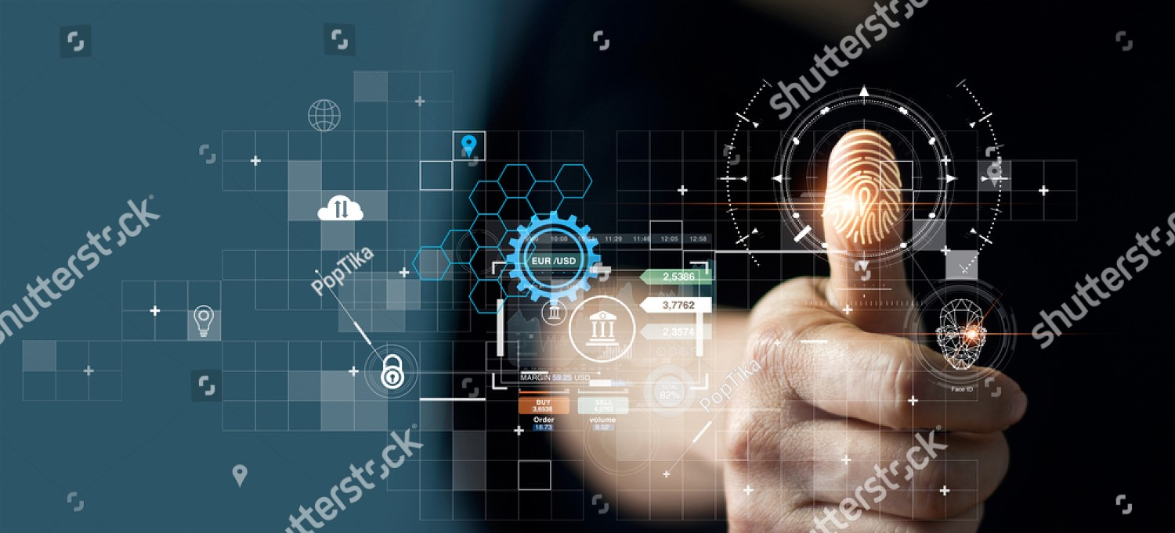
Building a Real-Time Facial Recognition System with Python and Excel Integration
Seamless Identity Verification: The Power of Facial Recognition

Slide 3

Problem statement and motivation:
Traditional fingerprint biometric systems in colleges face accuracy, cost, privacy, and operational challenges, impeding effective attendance tracking. To remedy this, our project proposes a cost-effective, user-friendly face recognition-based system. It will enhance accuracy, efficiency, and real-time monitoring, integrating seamlessly with a real-time database for instant updates.

Slide 4

ABSTRACT
The Python GUI Integrated Attendance System Using Face Recognition is a comprehensive solution designed to simplify and automate the process of taking attendance. This project leverages the power of face recognition technology through OpenCV to accurately identify individuals, coupled with a user-friendly Graphical User Interface (GUI) created using tkinter.
Key features of this system include its ease of use, with an intuitive interface that allows for quick and efficient attendance tracking. The system also includes password protection for registration, ensuring data security. Additionally, the system maintains detailed student records, creating and updating CSV files for student details and daily attendance.
The system enhances user experience by providing live attendance updates on the main screen, presenting information such as ID, name, date, and time in a clear and organized manner. Overall, this project offers a practical and effective solution for managing attendance in various educational or organizational settings.

Slide 5

Revolutionizing College Attendance: Overcoming Biometric System Challenges

Slide 6
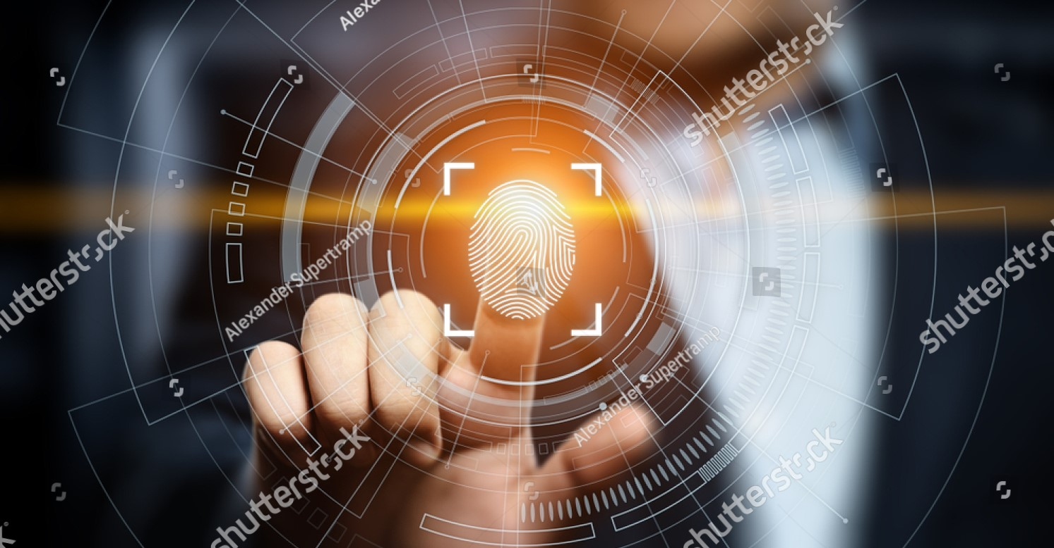
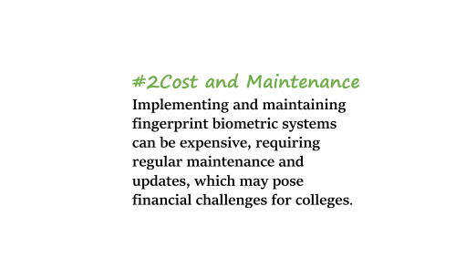
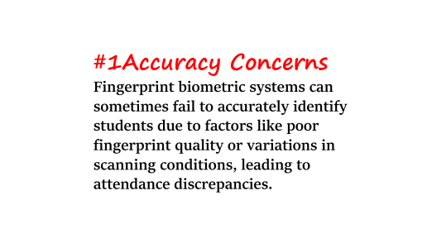
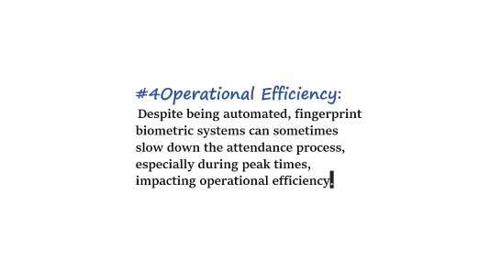
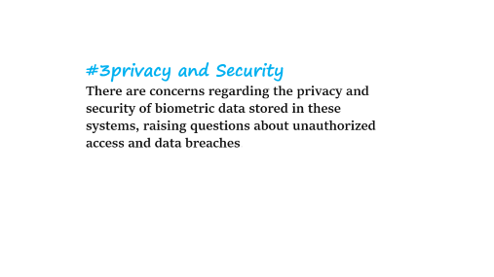
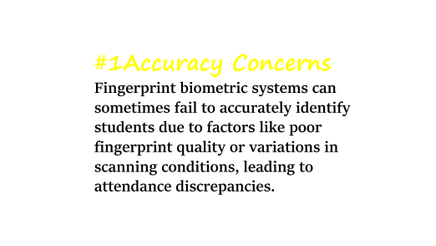

Slide 7
#1Accuracy Concerns
Fingerprint biometric systems can sometimes fail to accurately identify students due to factors like poor fingerprint quality or variations in scanning conditions, leading to attendance discrepancies.

Slide 8
#2Cost and Maintenance
Implementing and maintaining fingerprint biometric systems can be expensive, requiring regular maintenance and updates, which may pose financial challenges for colleges.

Slide 9
#3privacy and Security
There are concerns regarding the privacy and security of biometric data stored in these systems, raising questions about unauthorized access and data breaches.

Slide 10
#4Operational Efficiency:
Despite being automated, fingerprint biometric systems can sometimes slow down the attendance process, especially during peak times, impacting operational efficiency.

Slide 11
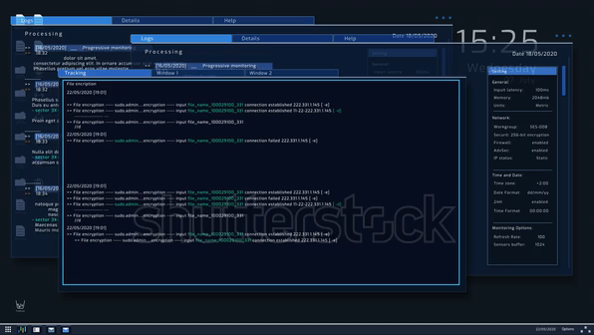
Objective : Developing a Robust Face Recognition-Based Attendance System

Slide 12
Objective of the project
Developing a Robust Face Recognition-Based Attendance System
Accuracy: Achieve high accuracy in student identification to eliminate errors and ensure reliable attendance tracking.
Efficiency: Improve the efficiency of the attendance process by reducing the time required for attendance marking.
Real-time Monitoring: Enable real-time monitoring of attendance data for both students and faculty.
Cost-effectiveness: Develop a system that is cost-effective to implement and maintain compared to traditional biometric systems.
User-Friendly Interface: Create a user-friendly interface for easy interaction and minimal training requirements.
Integration: Integrate the system with Excel for seamless data management and reporting.
Privacy and Security: Ensure that the system complies with privacy regulations and provides robust security measures to protect biometric data.

Slide 13
Software Requirements
Python: Install Python, as it will be used for coding the face recognition system.
OpenCV: Install OpenCV library for Python, which provides tools for image processing and computer vision tasks.
Excel: data management and integration with the face recognition system.
IDE: Use an Integrated Development Environment (IDE) such as PyCharm or Jupyter Notebook for coding and development.

Slide 14
Hardware Requirements
Adequate storage space for storing the database and images used for face recognition
The project requires a power supply cable and a stable internet connection for real-time excel integration and updates.
Camera: A webcam or any other camera device for capturing images for face recognition..
A computer with sufficient processing power and memory to run the face recognition system efficiently.

Slide 15
Methodolgy of the project
Initialize system: Launch the GNIT Smart Attendance System application.
Authenticate user: Log in using administrator credentials.
Navigate to attendance: Go to the "Mark Attendance" section.
Capture image: Activate camera and capture student's image.
Detect faces: Process image to detect faces using OpenCV.
Recognize faces: Compare detected faces with "Face Database."
Verify attendance: Match recognized faces and mark attendance.
Record data: Save attendance with ID, name, date, and time.
Provide feedback: Display success or failure on GUI.
Store data: Update Excel sheet or CSV with attendance records.
Review records: Administrators review and confirm attendance data.
Handle errors: Manually mark attendance if errors occur.
Monitor feed: Administrators monitor live attendance updates.

Slide 16
.
Cost-effective
While initial setup costs may be high, automated attendance systems can be cost-effective in the long run by reducing the need for manual record-keeping
Accuracy
Face recognition can provide more accurate attendance records compared to manual methods, reducing errors and discrepancies
Real-time Monitoring With real-time database integration, attendance can be monitored instantly, allowing for quick interventions if needed.
Convenience
Students can mark their attendance without the need for physical contact or ID cards, making the process more convenient.
Efficiency Automating attendance with face recognition can make the process more efficient, saving time for both students and faculty.
Advantages
01
02
04
03
05

Slide 17
.
01
02
03
04
05
Efficiency Automating attendance with face recognition can make the process more efficient, saving time for both students and faculty.
Accuracy
Face recognition can provide more accurate attendance records compared to manual methods, reducing errors and discrepancies
Real-time Monitoring With real-time database integration, attendance can be monitored instantly, allowing for quick interventions if needed.
Convenience
Students can mark their attendance without the need for physical contact or ID cards, making the process more convenient.
Cost-effective
While initial setup costs may be high, automated attendance systems can be cost-effective in the long run by reducing the need for manual record-keeping
Advantages

Slide 18
.
01
02
04
03
05
Deployment and Maintenance Setting up and maintaining a face recognition system with real-time database integration can be costly, especially for large institution
Resistance to Change
Some students and faculty may be resistant to adopting new technology for attendance, which can affect the system's effectiveness
Privacy Concerns
Using facial recognition technology for attendance raises privacy concerns, as it involves collecting and storing biometric data
Technical Challenges Face recognition systems may face technical challenges such as poor lighting conditions, occlusions, and variations in facial expressions, which can affect accuracy
Security Risks Storing biometric data in a database poses security risks, including data breaches and unauthorized access.
DisAdvantages

Slide 19
.
01
02
03
04
05
Privacy Concerns
Using facial recognition technology for attendance raises privacy concerns, as it involves collecting and storing biometric data
Technical Challenges Face recognition systems may face technical challenges such as poor lighting conditions, occlusions, and variations in facial expressions, which can affect accuracy
Deployment and Maintenance Setting up and maintaining a face recognition system with real-time database integration can be costly, especially for large institution
Resistance to Change
Some students and faculty may be resistant to adopting new technology for attendance, which can affect the system's effectiveness
Security Risks Storing biometric data in a database poses security risks, including data breaches and unauthorized access.
DisAdvantages

Slide 20
1. Modules-Connectivity Diagram:
- Describes the system's architecture, showing how different components interact and the data flow between them.
2.Interface:
- The graphical user interface (GUI) built using Tkinter, allowing users to interact with the system for registration, attendance marking, and viewing updates.
3.Data Collection:
- The process of capturing images and gathering data required for face recognition.
4. Face Recognition and Attendance Marking:
- Using OpenCV and the LBPH algorithm to recognize faces and mark attendance in the database.
5. Attendance Data Management:
- Managing and storing attendance records using tools like CSV, Numpy, Pandas, and datetime for efficient data handling.
6. Live Attendance Updates:
- Providing real-time updates of attendance status on the main screen, showing ID, name, date, and time for recognized students
Modules for the project

Slide 21
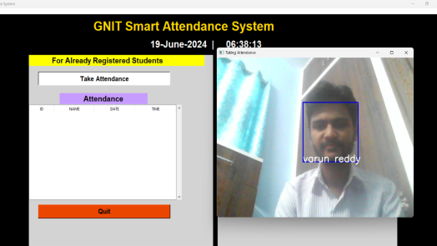
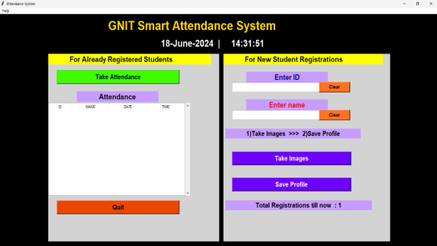
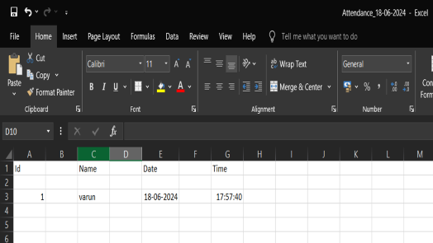
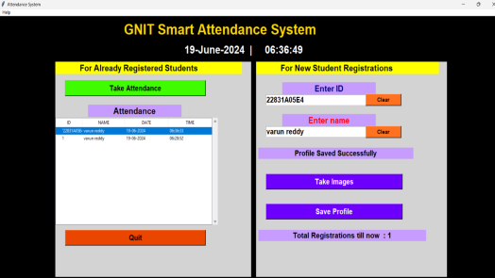
Project interface

Slide 22


Slide 23
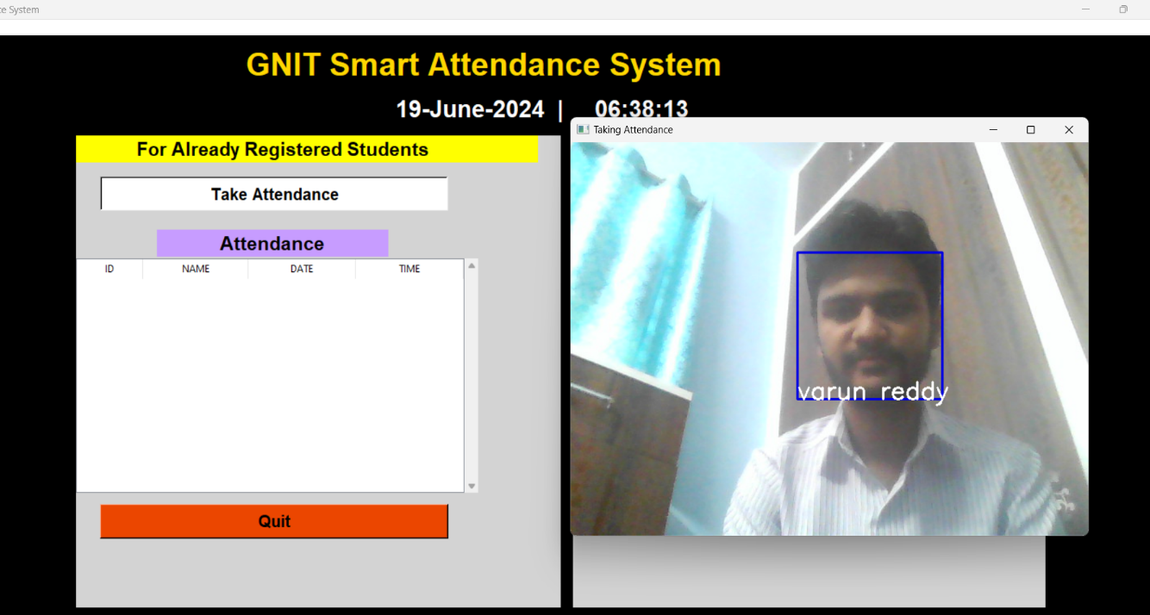

Slide 24
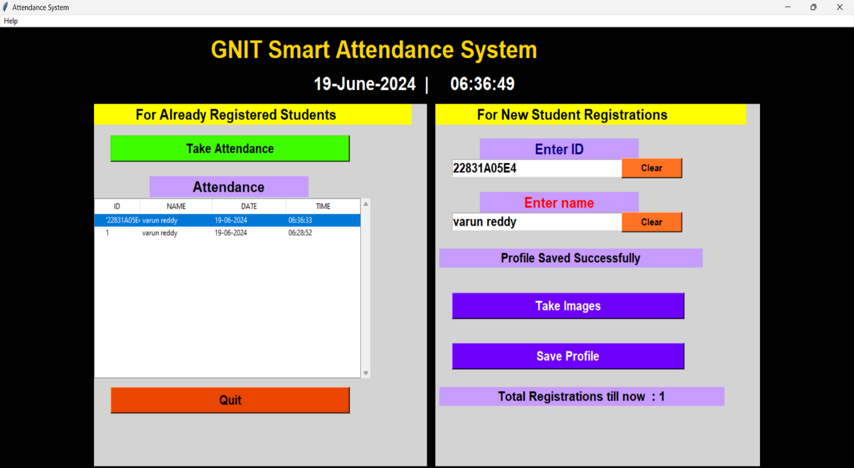

Slide 25


Slide 26
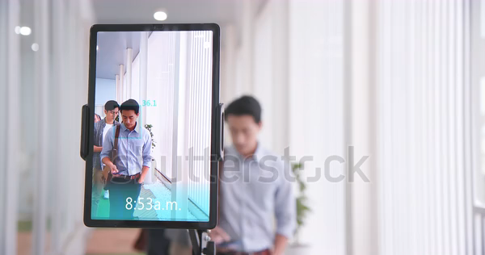
Sample video of project

Slide 27
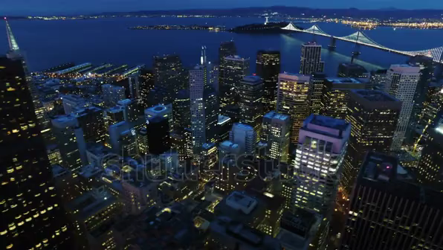
Conclusion
Our face recognition-based attendance system offers a modern solution to the challenges of traditional biometric systems.
By enhancing accuracy, reducing costs, ensuring privacy, and improving operational efficiency, our system provides a user-friendly approach to attendance tracking.
The integration with a excel sheet enables instant updates and transparency.
Colleges can streamline attendance processes and improve overall efficiency.
Embracing this technology allows colleges to overcome traditional system drawbacks and advance attendance tracking methods.

Slide 28


